Slide 1
Lewiston-Altura Public Schools
Fall 2024
Referendum
You spoke.
We listened.
Levy for Learning.
Bond for Basics.
Please Vote Nov. 5
www.cardinalstrong.net
Notes:
Welcome to an informational presentation about the L-A Public Schools Referendum the school district is asking residents to consider on November 5.
I am <<insert name>> and I am a/the <<insert role>> for L-A Public Schools. I am personally passionate about public education because <<insert reason>>.

Slide 2
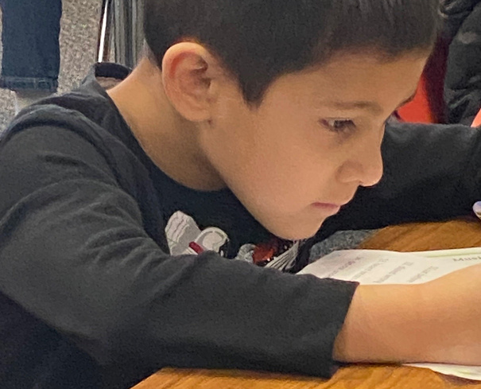
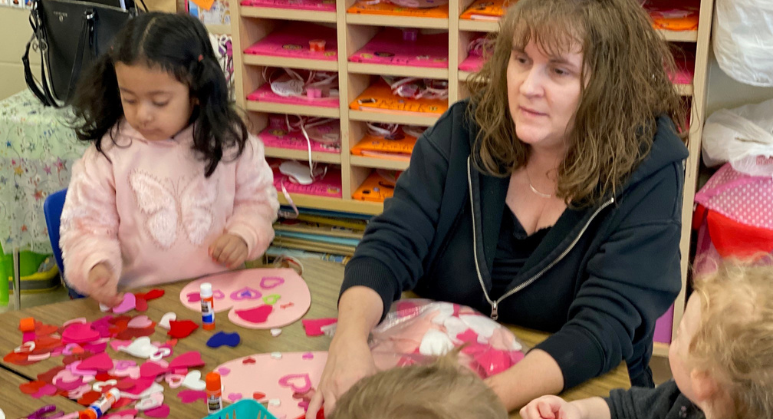
Lewiston-Altura Public Schools
Mission
To Build a
Caring,
Adaptable,
Respectful,
Determined,
Successful
Community of Learners.
GO CARDS!
Strategic Priorities:
Student Success
Effective Staffing
Finance
Facilities
Community Engagement
2023-2028 Strategic Plan
www.cardinalstrong.net
Notes:
Last year, L-A Public Schools completed a strategic planning process to revisit our Mission, Vision, Beliefs, and Strategic Priorities and Goals.
You will see our Mission reflected in everything we do… every decision we make… our daily teaching and our guiding light as we educate all learners.
The strategic plan establishes priorities and goals that we are striving to complete in the areas listed above. If you would like to learn more about the strategic plan, visit our website.
Today/Tonight, I would like to share information with you about the upcoming referendum which has identified goals under the areas of Finance and Facilities.

Slide 3
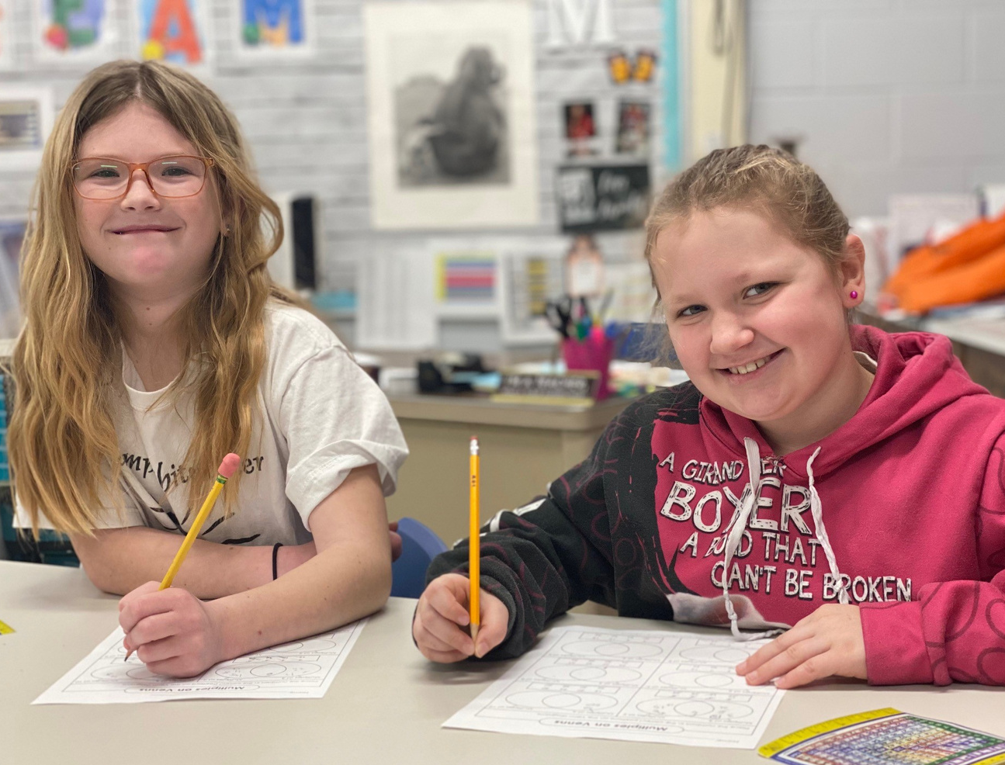
Lewiston-Altura Public Schools
About Us
Lifelong learning for all residents - infants to seniors.
Standards-based instruction = Student academic success.
Preschool & childcare.
Rigorous high school classes.
www.cardinalstrong.net
Notes:
Allow me to begin with a few facts that you may not know about L-A Public Schools.
We provide learning for all students – from infants in ECFE classes to senior citizens who participate in Community Education classes and events.
For all learners, we focus on standards-based instruction, meaning all teaching is aligned to state standards for academic success E-12 and all adult learning is grounded in best practices.
Our preschool and childcare programs provide an early start or additional support to achieve academic success as they too are standards-based and aligned … to daily, school instruction as well as the state standards.
At the high school level, students can access advanced placement classes as well as many offering in concurrent enrollment. Both provide rigor for students and saving for parents’ pocketbooks as satisfactory completion will earn students college credit – free of charge – while attending classes at L-A High School.

Slide 4
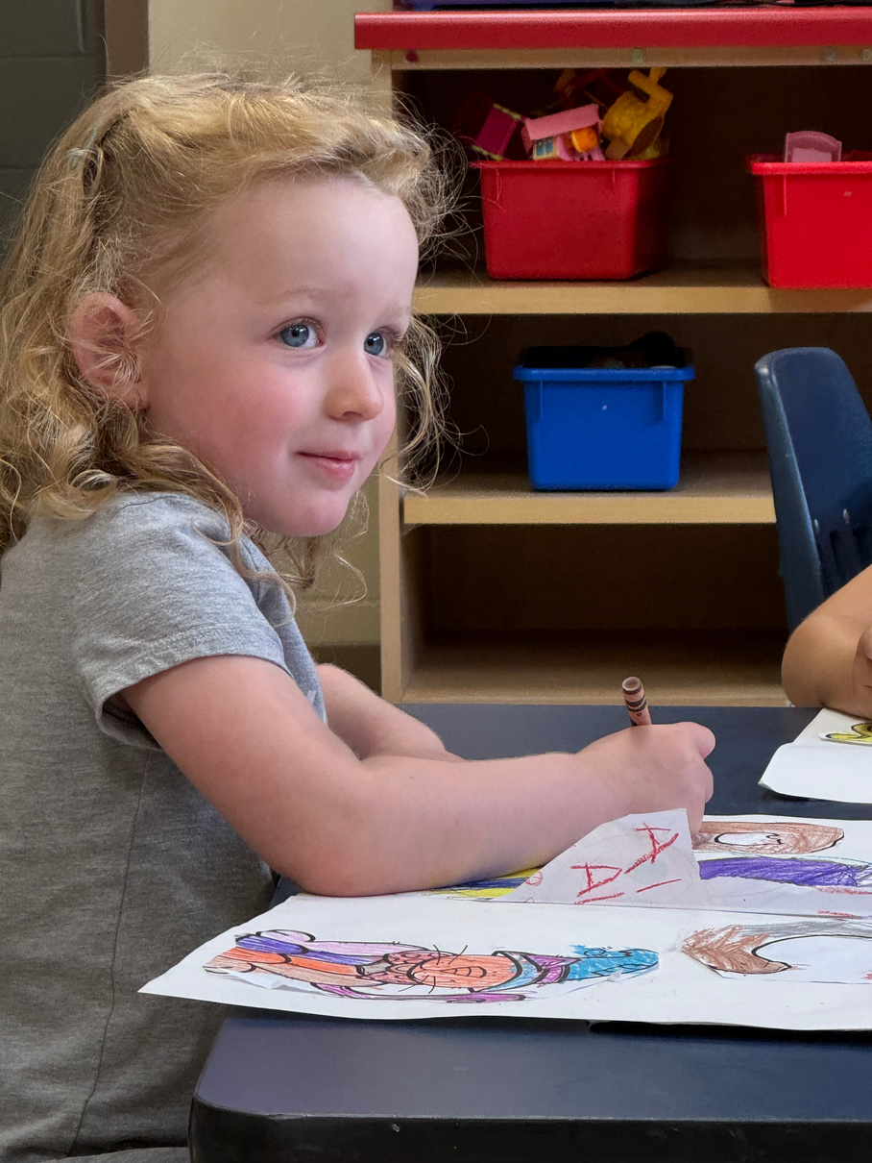
Lewiston-Altura Public Schools
Needs & Solutions
Lewiston-Altura Public schools is facing significant budget challenges and facilities needs that far exceed annual funding.
QUESTION #1:
LEVY FOR LEARNING
$760/student for 10 years to support classroom learning:
Teachers & Staff
Curriculum & Classroom supplies
Extracurricular activities
QUESTION #2:
BOND FOR BUILDING
$19.95 million (incl. bond costs) to improve learning spaces:
Classroom upgrades
Mechanical & electrical systems upgrades
School safety & security improvements
www.cardinalstrong.net
Notes:
As a school district we are facing significant budget challenges and facilities needs that far exceed annual funding.
To begin to address both challenges, we are asking residents to consider a two-question referendum this fall.
<<Read the questions from the slide.>>

Slide 5
Lewiston-Altura Public Schools
WHY?
Rising costs.
Persistent Budget Deficit
WHY?
Declining enrollment.
The school district is rightsizing its budget for the 2024-25 with $771,000 in budget adjustments, including reductions in staff, extracurricular activities, and bus routes; and revenue increases in activity fees, booster club donations, and the sale of school district land.
WHY?
State funding that has not
kept pace with inflation.
Because of current funding formulas, even with additional operating levy dollars, the school district will face additional adjustments (reductions and fee increases) in coming years.
www.cardinalstrong.net
Notes:
Some more information about our operations budget.
Operating budgets fund everything that happens within the classroom and school – teachers, instructional materials (curriculum), supplies, etc. Everything our students need to learn.
We face a budget deficit due to Rising Costs, Declining Enrollment, and State Funding that has not kept up with inflation.
For this school year, the school board adopted $771,000 in budget adjustments (read above).
If approved, the referendum will greatly improve our operating budget, but sadly… additional budget adjustments will still be needed in coming years due to declining enrollment.

Slide 6
Lewiston-Altura Public Schools
Outdated Learning Spaces
Outdated classrooms & no shared learning spaces.
Outdated heating & cooling systems; electrical does not support today’s learning.
Worn finishes.
Building entries and parking lots not safe for students.
www.cardinalstrong.net
Notes:
Our facilities challenges are many. Primarily because we have not had a bond referendum approved by voters in the past 27 years.
Applause goes to our maintenance staff – they do a great job maintaining what we have. And their creativity to fix outdated systems and tenacity at researching used parts for equipment, is a tribute to their dedication to students and learning.
That said, our outdated classrooms, worn finishes, classrooms that are often too cold or too warm, do not support today’s learning.
And student and staff safety is a concern daily at our school entrances and in our parking lots as students, buses, and cars intermingle twice a day.

Slide 7
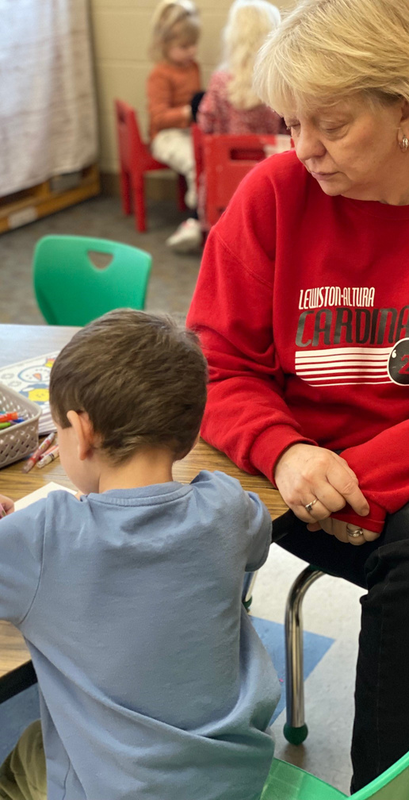
Lewiston-Altura Public Schools
Solutions
L-A Public Schools is asking voters to consider a two-question referendum on Nov. 5
Levy for Learning
Bond for Basics
QUESTION #1:
LEVY FOR LEARNING
$760/student for 10 years to support classroom learning:
Teachers & Staff
Curriculum & Classroom supplies
Extracurricular activities
QUESTION #2:
BOND FOR BUILDING
$19.95 million (incl. bond costs) to improve learning spaces:
Classroom upgrades
Mechanical & electrical systems upgrades
School safety & security improvements
Please Vote Nov. 5
www.cardinalstrong.net
Notes:
You spoke. In the 2023 referendum election. And in the post-referendum survey as community engagement meetings.
We listened. The School Board listened. And the Facilities Taskforce listened.
And the School Board voted UNANIMOUSLY to love forward with Levy for Learning and Bond for Basics on the ballot this November.
<<Read the slide for Q1 and Q2.>>

Slide 8
Plumbing
Tuckpointing
Windows Replacements
Door and Hardware Upgrades
Gym Equipment and Flooring Upgrades
Parent Bus Drop-off and Pick up Site Improvements
New Playground Equipment
Remodeled Office Space
Small Addition to create secure entry, remodel existing space into family restroom
Classroom Casework and Wall Upgrades to Address Sound Issues, Remodeling of Existing Space to Create Larger Kindergarten Rooms
Remodeling of Group Restrooms to Increase Capacity and meet American Disabilities Act (ADA) Requirements
Lewiston-Altura Public Schools
Elementary Improvements
Bond for Basics
Please Vote Nov. 5
www.cardinalstrong.net
Notes:
You spoke. In the 2023 referendum election. And in the post-referendum survey as community engagement meetings.
We listened. The School Board listened. And the Facilities Taskforce listened.
And the School Board voted UNANIMOUSLY to love forward with Levy for Learning and Bond for Basics on the ballot this November.
<<Read the slide for Q1 and Q2.>>

Slide 9
Fire alarm system replacement
Plumbing
Tuckpointing
Roofing Replacements
Windows replacements
Door and hardware upgrades
Classroom casework replacements
Main gym flooring replacement
New C-Gym bleachers
Site improvements
An addition to create a secured entry and provide adequate office space
Renovations to update the science and art classrooms
Renovations to update the locker rooms
Update the existing career and technical education (CTE) space
New bus drop-off area
Lewiston-Altura Public Schools
High School
Improvements
Bond for Basics
Please Vote Nov. 5
www.cardinalstrong.net
Notes:
You spoke. In the 2023 referendum election. And in the post-referendum survey as community engagement meetings.
We listened. The School Board listened. And the Facilities Taskforce listened.
And the School Board voted UNANIMOUSLY to love forward with Levy for Learning and Bond for Basics on the ballot this November.
<<Read the slide for Q1 and Q2.>>

Slide 10
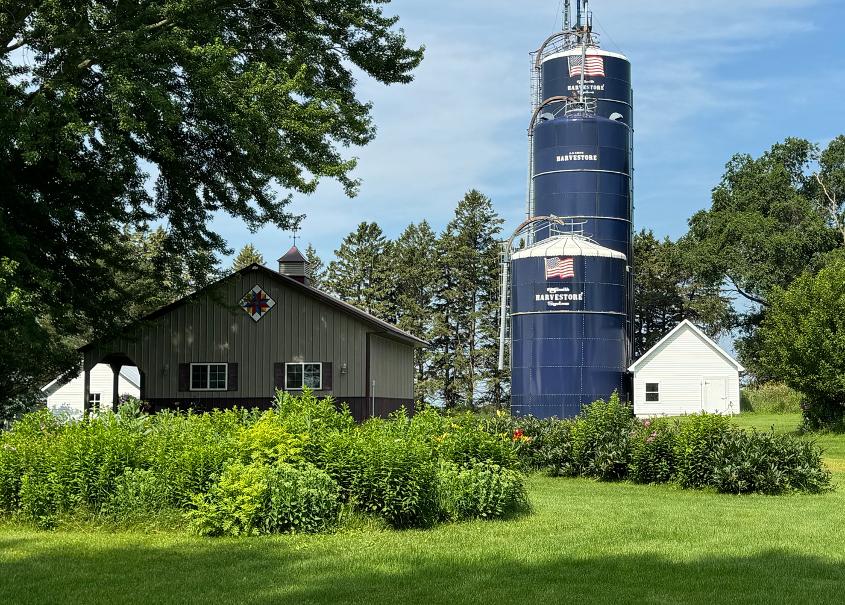
Lewiston-Altura Public Schools
Tax Impact
For both questions:
$200,000 Home = $40.67 / month
$250,000 Home = $52.58 / month
What will it cost you?
Tax Calculator at Cardinalstrong.net
IMPORTANT NOTE... 70% Tax Credit
for Agricultural Landowners
Tax credit
MORE THAN 62% of L-A Residents quality for this tax credit!
www.cardinalstrong.net
Notes:
There is a cost to these improvements.
We worked hard to reduce the referendum ask to “just the basics” because we heard residents say that an additional tax burden would be a challenge for them.
If both questions are approved, <<read the slide>>
If you own agricultural land, there is a significant tax credit – 70%, through the Ag2School program.
We did our research and learned that 62% of L-A Residents qualify for the Ag2School program. And the best news… it is automatically applied to your tax bill, there are no additional steps for agricultural landowners to take.

Slide 11
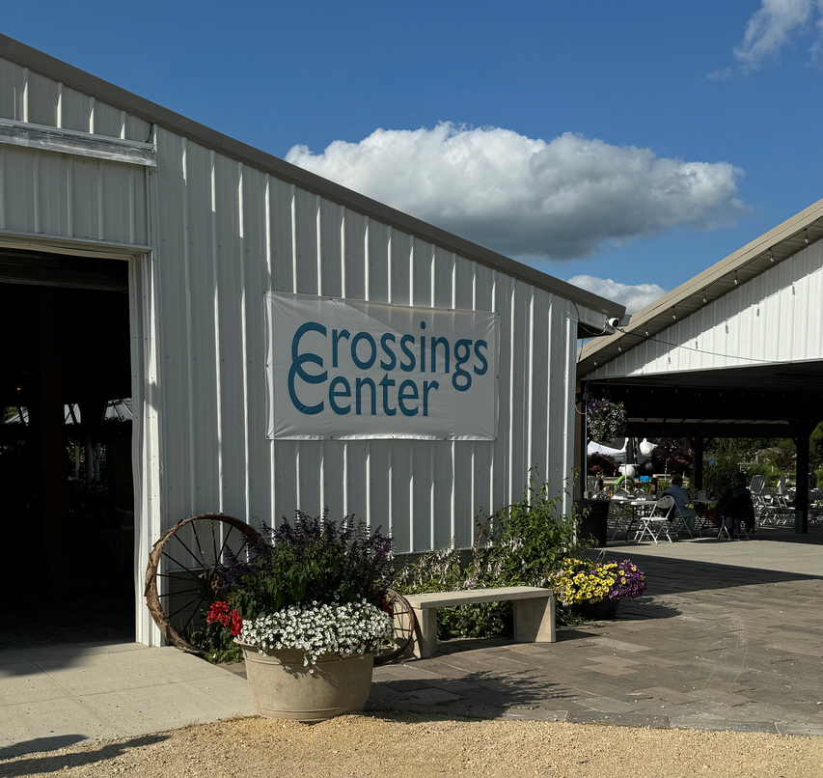
Lewiston-Altura Public Schools
Levy for Learning & Bond for Basics:
An Investment in Students, Families, and Communities
www.cardinalstrong.net
Notes:
This referendum is an investment in students, families, and communities. The future success of our communities depends on the success and vitality of our schools.

Slide 12
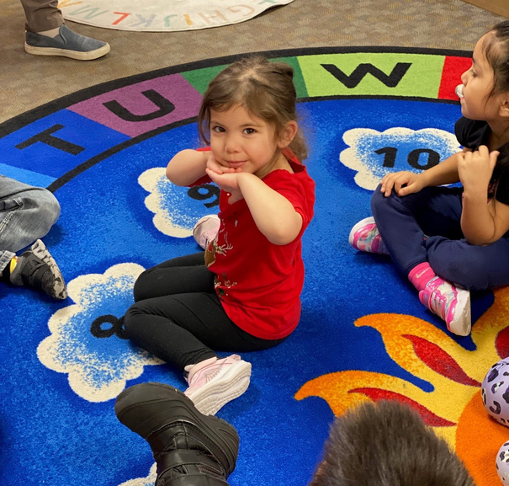
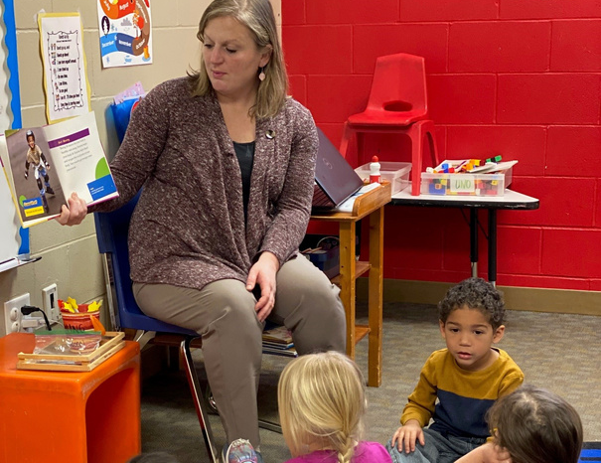
Lewiston-Altura Public Schools
Thank you for your on-going support
Share this message with your family, friends, and neighbors:
Watch a video.
Attend a community meeting.
Host a neighborhood social.
Invite school leaders to present to your club, organization, or business.
Participate in phone calling to educate voters.
Follow L-A Public Schools on Facebook to receive election updates.
Amazing Students
Dedicated Teachers & Staff
Relationships with students are a priority in L-A Public Schools.
Our teachers and staff are
future-focused and dedicated servant leaders.
Please Vote Nov. 5
www.cardinalstrong.net
... An equation for student success now and in the future!
Notes:
<<Read this slide>>

Slide 13
Lewiston-Altura Public Schools
We are
Cardinal Strong!
You spoke. We listened.
Levy for Learning.
Bond for Basics.
Vote Nov. 5.
www.cardinalstrong.net
Notes:
Please vote on or before November 5th.
Thank you.
I would be happy to answer any specific questions you may have about our schools or the referendum.
NOTE: There are prepared FAQ slides following for: Student Success
Budget
Enrollment

Slide 14
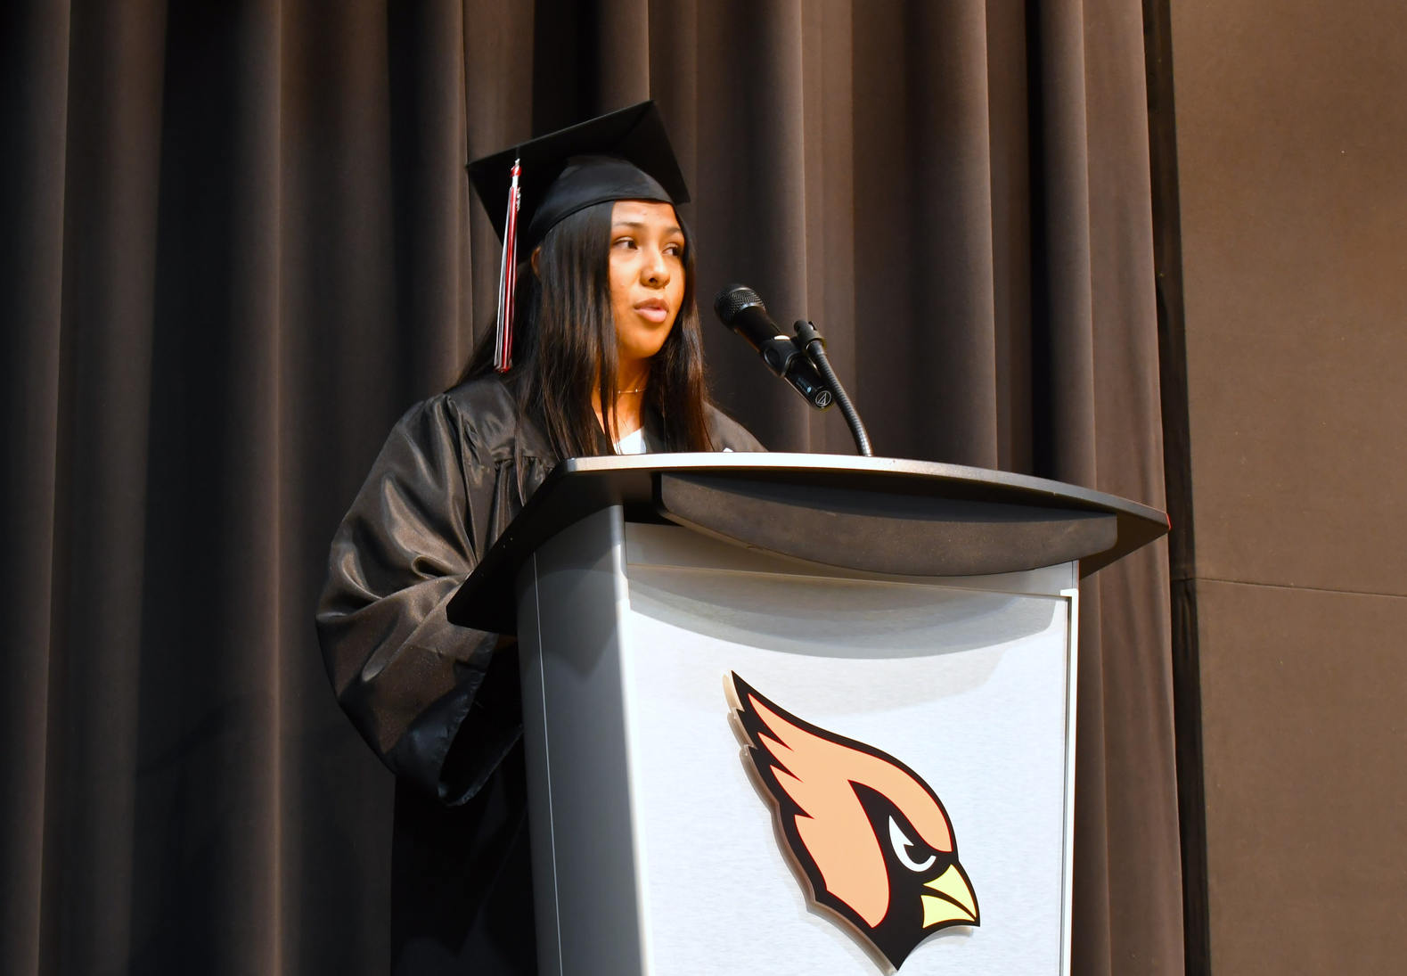
Student Success
ECFE classes and Preschool options prepare our youngest learners aligned to state standards.
Elementary students continue to score above state averages in MCA reading and math tests.
High School students can access up to 27 free college credits through concurrent enrollment.
Graduation rates continue to soar and our graduates are ready for career, college and/or work success.
FREQUENTLY ASKED QUESTION:
What are some indicators of student success in L-A Public Schools?
www.cardinalstrong.net

Slide 15
Budget
The school district is rightsizing its budget for the 2024-25 with $771,000 in budget adjustments
Reductions
Staff, extracurricular activities, and bus routes.
Revenue Increases
Activity fees, booster club donations, and the sale of school district land.
FREQUENTLY ASKED QUESTION:
How did the school district reduce the budget for 2024-25?
www.cardinalstrong.net

Slide 16
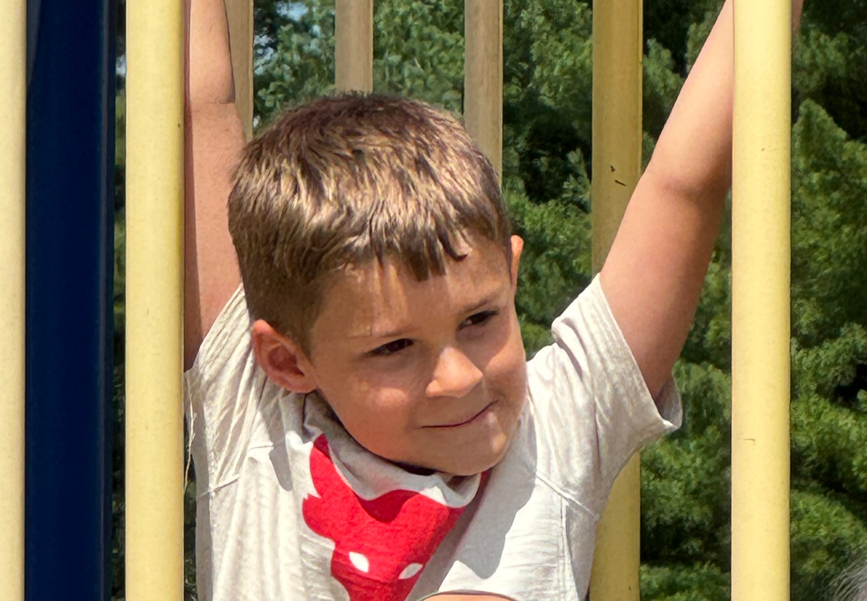
Enrollment
During the 2023-24 school year, L-A Public Schools enrolled 559 K-12 students.
The District’s total enrollment is projected to decline by roughly 14% to 483 students over the next 5 years, stabilizing in 2030.
During the 2022-23 school year, L-A Public Schools gained 151 students through open enrollment.
Reasons families choose a school: geography, religion and/or family beliefs, parent/family work location, childcare, specific curriculum/program offerings or personal preferences.
FREQUENTLY ASKED QUESTION:
What is the current enrollment in L-A Public Schools?
www.cardinalstrong.net

